Slide 1


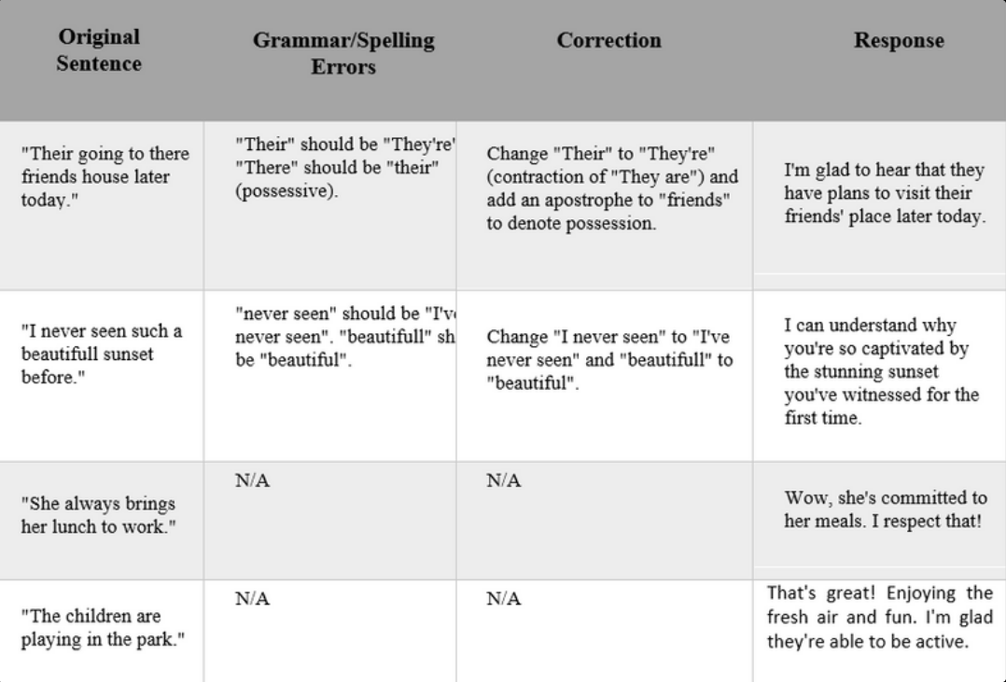
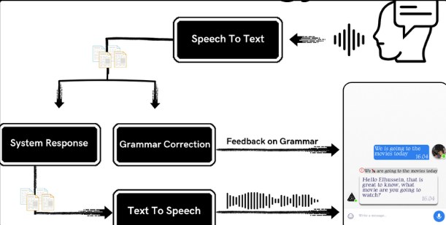
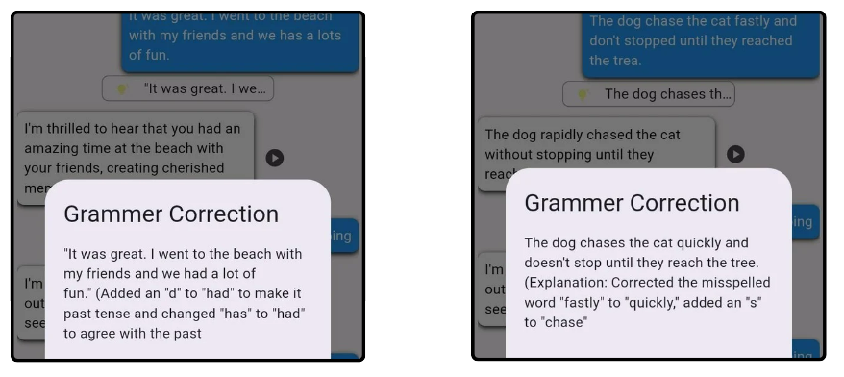
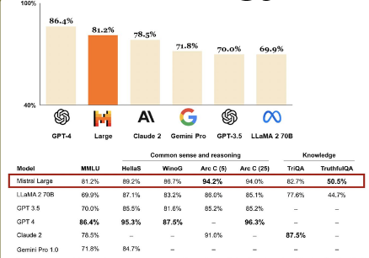
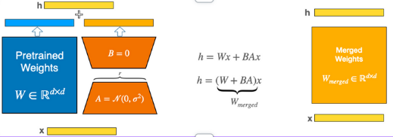
This research addresses the significant challenges English learners face due to a shortage of qualified teachers and effective resources, particularly in self-correcting pronunciation and grammatical errors. Given that English is the most desired language to learn globally, we propose developing a user-friendly mobile application leveraging advanced AI models to tackle these issues. Primary Objective: The primary objective is to create an efficient English learning application that helps learners of all levels and backgrounds identify and correct pronunciation and grammatical errors. Application Functionality: The app uses cutting-edge AI to listen to spoken English, detect errors, and provide detailed feedback for effective language skill improvement. It is fine-tuned to understand a variety of accents and dialects. Global Accessibility: The app aims to help learners worldwide improve their English proficiency efficiently, providing a mobile platform for learning at one's own pace, regardless of location. Promoting Confident Communication By addressing the educational gap due to a shortage of teachers, the app promotes confident and accurate communication among learners globally, offering personalized feedback and adaptive learning paths. Innovative Features: Speech-to-Text and Text-to-Speech Integration: Enhances both speaking and listening skills. Interactive Scenarios: Mimics real-life situations for practical experience. Progress Monitoring and Analytics: Tracks progress and provides personalized recommendations.
TalkTact
By: Elsayed Mostafa , Lunary Mohamed , Ali Sameh , Elhussein Gomaa ,
Youssef Ahmed , Mostafa Mohmed
Supervised by: Prof.Dr. Howida Shedeed, Head of Scientific Computing Department, and TA. Reham Ahmed
Faculty of Computer and Information Sciences - Ain Shams University
API Integration to provide seamless connectivity and real-time feedback.
Introduction
Results
This research addresses the significant challenges English learners face due to a shortage of qualified teachers and effective resources, particularly in self-correcting pronunciation and grammatical errors. Given that English is the most desired language to learn globally, we propose developing a user-friendly mobile application leveraging advanced AI models to tackle these issues. Primary Objective: The primary objective is to create an efficient English learning application that helps learners of all levels and backgrounds identify and correct pronunciation and grammatical errors.
Application Functionality: The app uses cutting-edge AI to listen to spoken English, detect errors, and provide detailed feedback for effective language skill improvement. It is fine-tuned to understand a variety of accents and dialects.
Global Accessibility: The app aims to help learners worldwide improve their English proficiency efficiently, providing a mobile platform for learning at one's own pace, regardless of location. Promoting Confident Communication By addressing the educational gap due to a shortage of teachers, the app promotes confident and accurate communication among learners globally, offering personalized feedback and adaptive learning paths.
Innovative Features: Speech-to-Text and Text-to-Speech Integration: Enhances both speaking and listening skills. Interactive Scenarios: Mimics real-life situations for practical experience. Progress Monitoring and Analytics: Tracks progress and provides personalized recommendations.
Implementing this methodology yields a robust language learning application that enhances users' English proficiency, confidence, and fluency. It provides a cost-effective, accessible solution, particularly beneficial for shy learners or those with limited financial resources. Through personalized feedback, adaptive learning paths, and immersive practice opportunities, the application promotes comprehensive skill development and continuous improvement, making language learning engaging and effective.
Methods
Screenshots from the app
System Architecture
Mistral AI 7B is the used model , but why?
Conclusions
The development of this advanced English learning application successfully addresses the challenges faced by learners due to the scarcity of qualified teachers and effective resources. By utilizing cutting-edge AI models, the app provides precise detection and correction of pronunciation and grammatical errors, significantly enhancing the learning experience. This user-friendly and accessible tool caters to the global demand for English proficiency, enabling learners from diverse backgrounds to improve their language skills confidently and accurately. The research and resulting application contribute to closing the educational gap, promoting effective communication, and meeting the growing need for high-quality English learning resources worldwide.
Fine Tuning With LoRA
Bibliography
[1] A. Vaswani et al., "Attention Is All You Need," Submitted on 12 Jun 2017 (v1), last revised 2 Aug 2023 (this version, v7).
[2] L. Xu et al., "Parameter-Efficient Fine-Tuning Methods for Pretrained Language Models: A Critical Review and Assessment," Submitted on 19 Dec 2023.
[3] E. J. Hu et al., "LoRA: Low-Rank Adaptation of Large Language Models," Submitted on 17 Jun 2021 (v1), last revised 16 Oct 2021 (this version, v2).
[4] K. Tian et al., "Fine-tuning Language Models for Factuality," Submitted on 14 Nov 2023.
[5] A. Q. Jiang et al., "Mistral 7B," Submitted on 10 Oct 2023.
[6] M. Ryabinin et al., "SWARM Parallelism: Training Large Models Can Be Surprisingly Communication-Efficient," Submitted on 27 Jan 2023 (v1), last revised 29 Jun 2023 (this version, v2).
[7] Berlitz, "The Most Spoken Languages in the World," [Online]. Available: [1] Vaswani, A. et al. (2023) Attention is all you need, arXiv.org. Available at: https://arxiv.org/abs/1706.03762 (Accessed: 25 June 2024).
[2] Radford, A. et al. (2022) Robust speech recognition via large-scale weak supervision, arXiv.org. Available at: https://arxiv.org/abs/2212.04356 (Accessed: 25 June 2024).
[3] Harere, A.A. and Jallad, K.A. (2023) Quran recitation recognition using end-to-end deep learning, arXiv.org. Available at: https://arxiv.org/abs/2305.07034 (Accessed: 26 June 2024).
Text-To-Speech and Speech-To-Text technologies, this enables users to practice speaking and receive real-time transcriptions of their speech and also listen to correct pronunciations and practice their listening skills.
Order online at https://www.postersession.com/order/

